Slide 1
Database Technologies

Slide 2
Day 1

Slide 3
What is Data?
Facts and statistics stored or free flowing over an network.
Raw and unprocessed.
When data becomes processed into something meaningful, it becomes information.

Slide 4
Database
Collection of interrelated data which is used to retrieve, insert and delete the data efficiently.
Data is organized in the form of table, schema, views, reports, etc.
Insertion, retrieval, and deletion of data in a database is very easy.

Slide 5
Database Management Systems
Software that allows creation, definition and manipulation of a database.
Provides tools to perform various operations such as creating databases, storing and updating of the data, creating the tables and so on.
Provides protection and security to the databases.

Slide 6

Popular DBMS Technologies

Slide 7
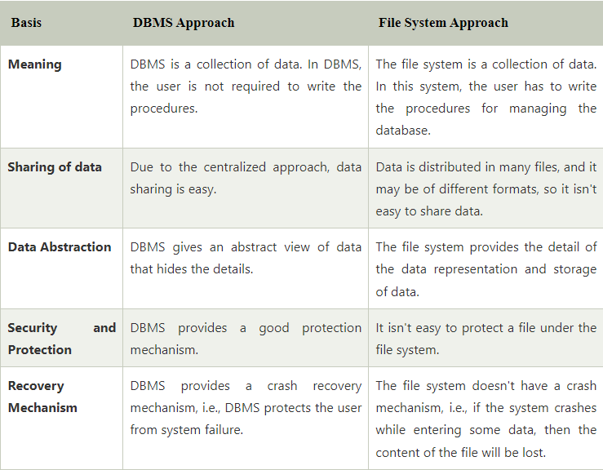
Databases v/s File Systems

Slide 8
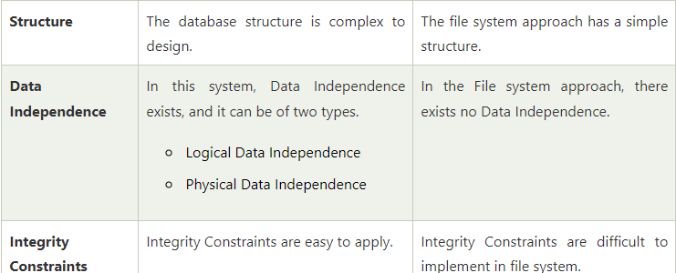
Databases v/s File Systems (contd…)

Slide 9
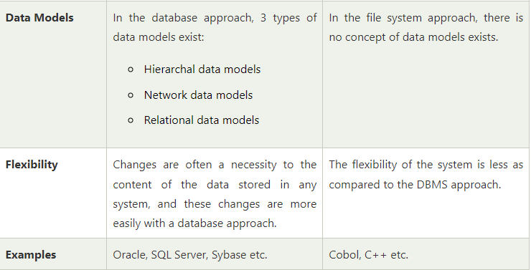
Databases v/s File Systems (contd…)

Slide 10
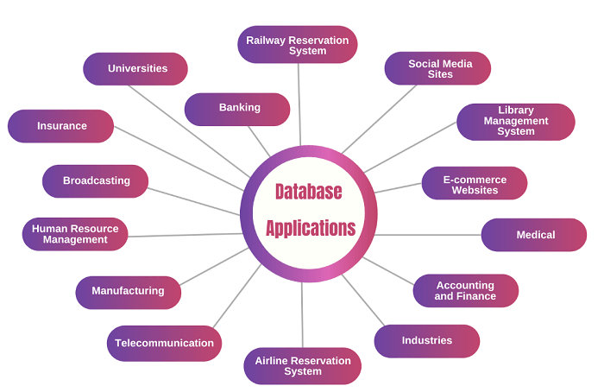
Applications of DBMS

Slide 11
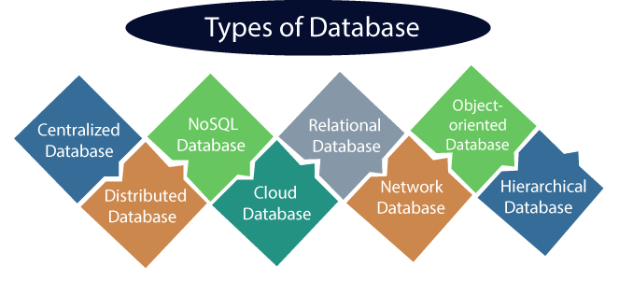
Types of DBMS

Slide 12
Relational Databases
Most widely used
Easiest
Basis: Normalizing data in the rows and columns of the tables (entities).
Language used: Structured Query Language (SQL)

Slide 13
Object Oriented Databases
Uses the object-based data model approach for storing data in the database.
Data is represented and stored in the form of objects which are similar to that of Objects used in any Object Oriented Programming Languages.
Supports Object Oriented features such as Inheritance and Polymorphism.
Example: ODABA, Gemstone/S, ObjectStore etc.

Slide 14
Object Relational Databases
It combines the features of both relational databases and Object Oriented Databases.
It supports Object Oriented programming features such as Inheritance and Polymorphism.
Also it supports referential integrity which is similar to that of RDBMS.
Ex: Oracle DB, PostgreSQL, IBM Db2.

Slide 15
NoSQL Databases
Uses: Storing wide range of data sets.
It is not a relational database. Data is not only stored in tabular form, but also in various other forms such as Key -Value pairs, graph format, document format etc. .
It can handle data in high velocity.
Ex: MongoDB.

Slide 16
Assignment No.1
Compare Relational Databases, Object Relational Databases and NoSQL databases.
What are the advantages of using ORDBMS over RDBMS?
What are the advantages of NoSQL over RDBMS?.

Slide 17
Relational Model Concepts

Slide 18
Table
In Relational Model, the relations are saved in tabular format.
It is stored along with entities.
Two properties : rows and columns
Rows represent records and column represents attributes.

Slide 19
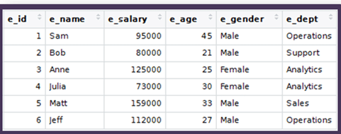
Tables

Slide 20
Attributes
Each column in a table is called an attribute.
Attributes are those properties which define a relation.
Ex: If we consider the entity (table) called Student, then Student_Roll_No,Name, marks, etc. can be considered as an attribute.

Slide 21
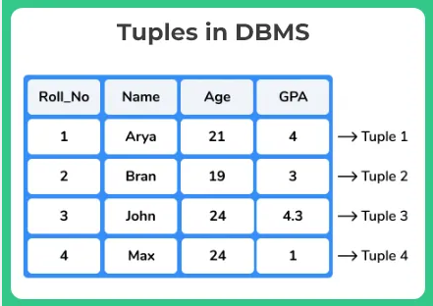
Tuples
A Tuple represents a single row of a table.

Slide 22
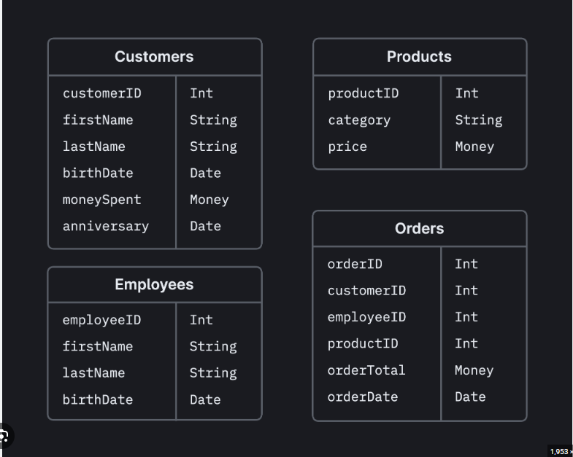
Relation Schema
Relation Schema represents the name of the relation with its attributes.

Slide 23
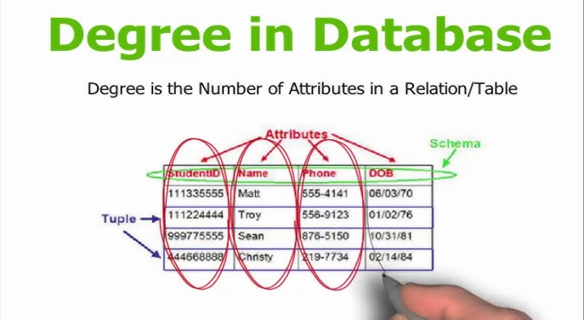
Degree
The total number of attributes in a relation is called the degree of the relation.

Slide 24
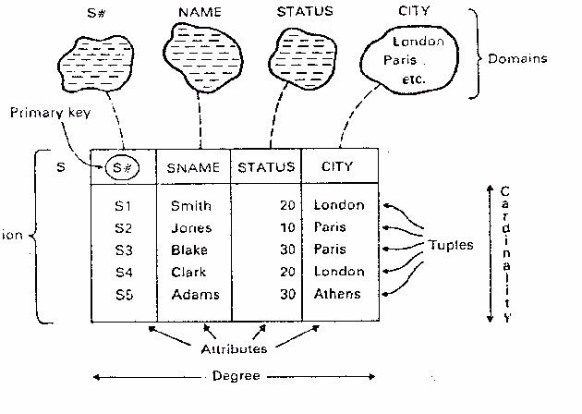
Cardinality
The total number of rows present in the table is known as Cardinality.

Slide 25
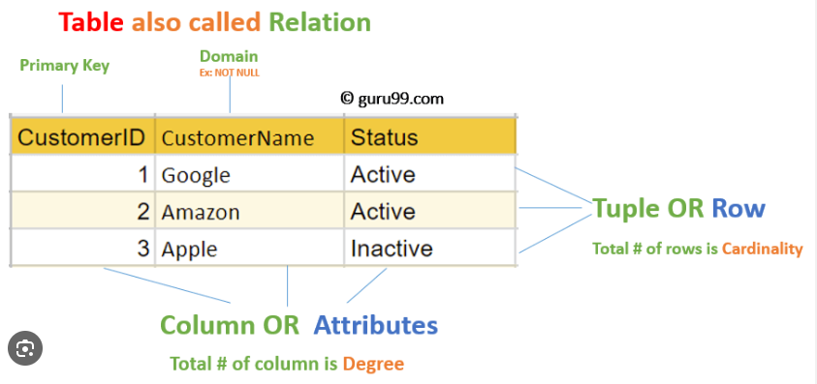
Column
A column represents a set of values for a specific attribute.

Slide 26
Keys in DBMS
Keys are attributes which helps us to identify the rows in a table.
We can find the relation of two tables using keys.
We can also find a unique record or row from the table using keys.

Slide 27
Why Keys are needed?
Identification of a row of data in a table.
Establish a relationship between as well as identify the relation between tables.
Enforce identity and integrity in a relationship.

Slide 28
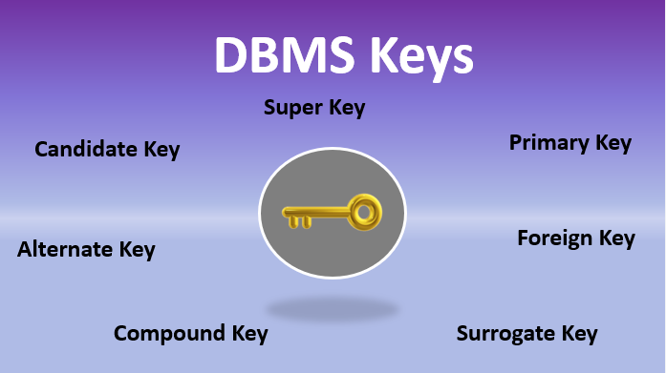
Types of keys in DBMS

Slide 29
Types of keys in DBMS
Super Key: A super key is a group of single or multiple keys which identifies rows in a table.
Primary Key: It is a column or group of columns in a table that uniquely identify every row in that table.
Candidate Key: A set of attributes that uniquely identifies tuples in a table. A candidate key is a super key with no repeated attributes.

Slide 30
Types of Keys in DBMS (contd…)
Alternate key: An alternate key is a column or group of columns in a table that uniquely identify every row in that table.
Foreign Key: It is a column that creates relationship between two tables. The purpose of Foreign keys is to maintain data integrity and allow navigation between two different instances of an entity.
Compound Key: Compound key has two or more attributes that helps you to uniquely recognize a specific record. It is possible that each column may not be unique by itself in the database.

Slide 31
Types of Keys in DBMS (contd…)
Composite Key: An artificial key which aims to uniquely identify each record is called a composite key. Composite keys are considered as unique because these are created when there is no natural primary key.
Surrogate Key: An artificial key which is used to uniquely identify a record.These keys are unique because they are created when you don’t have a natural primary key.

Slide 32
Three Layer Schema
In this database architecture, there are three layers:
View Layer
Conceptual Layer
Physical Layer

Slide 33
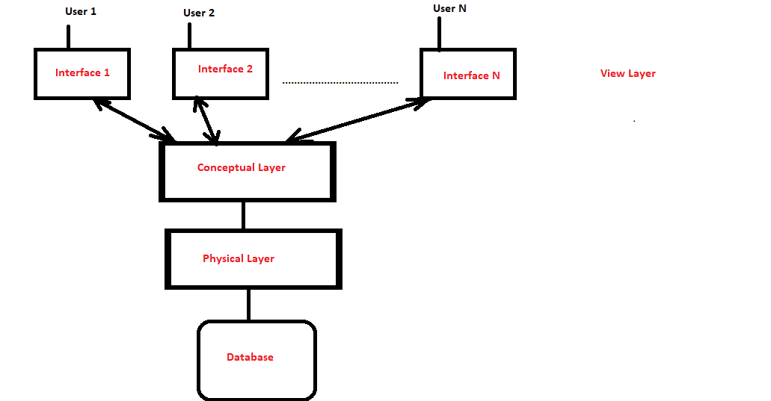
3- Layer Schema

